Slide 1

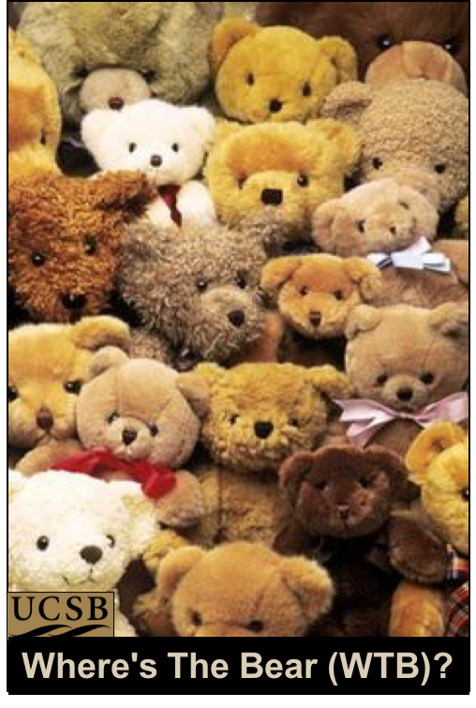


Where’s the bear? – Automatic Wildlife Image Processing Using IoT and Edge Cloud Systems
IotDI’17
Andy Rosales, Nevena Golubovic, Chandra Krintz & Rich Wolski
Dept. of Computer Science,
UC Santa Barbara
Presented by: Arjun Prakash
Proprietary + Confidential
Aug. 2017

Slide 2
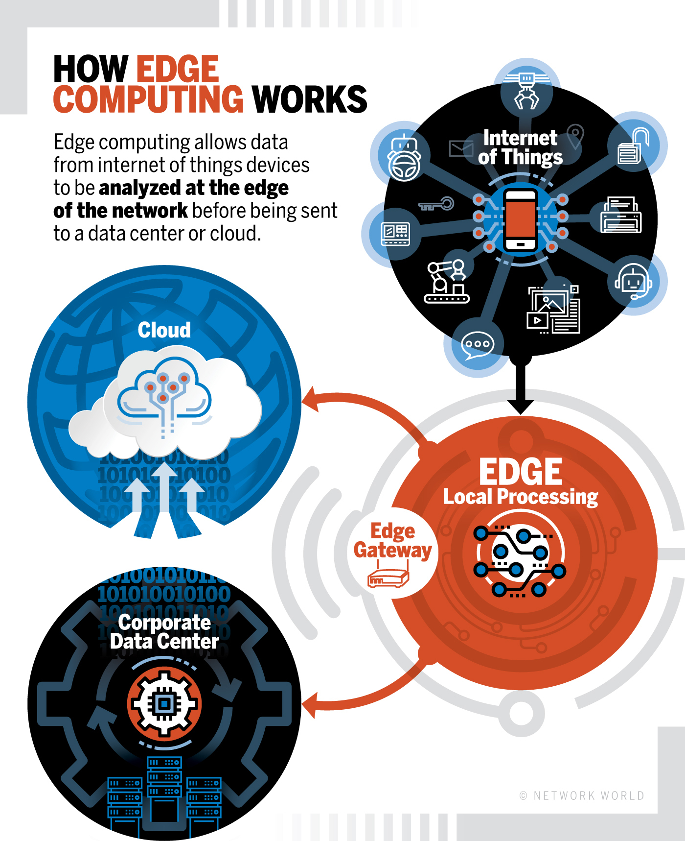
What is Edge Cloud Systems
Notes:
Method of optimizing cloud computing systems by performing data processing at edge of network.

Slide 3
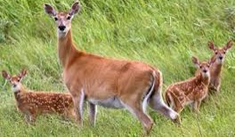
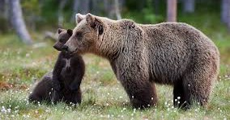
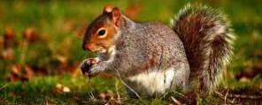
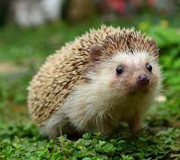

Introduction
Evaluating diversity and health of animals.
Automated Animal classification
Avoiding dangerous human/animal encounters & overlap
Monitoring change in land use

Slide 4
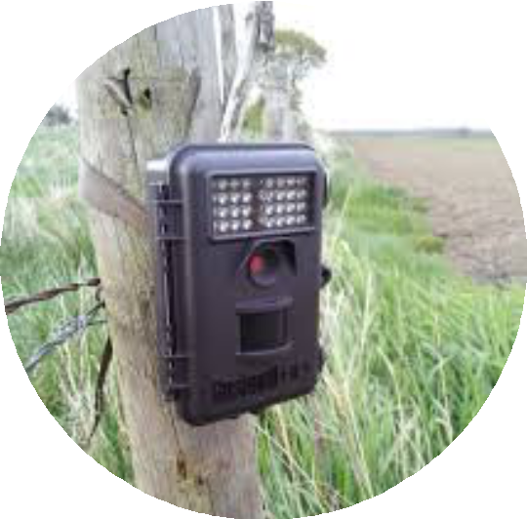
Digital Photography
Alternative to labor-intensive observation & tracking
Cost effective and scalable
Safe
Increasingly autonomous
Motion triggered
IoT devices
Reconyx HC500 Hyperfire

Slide 5
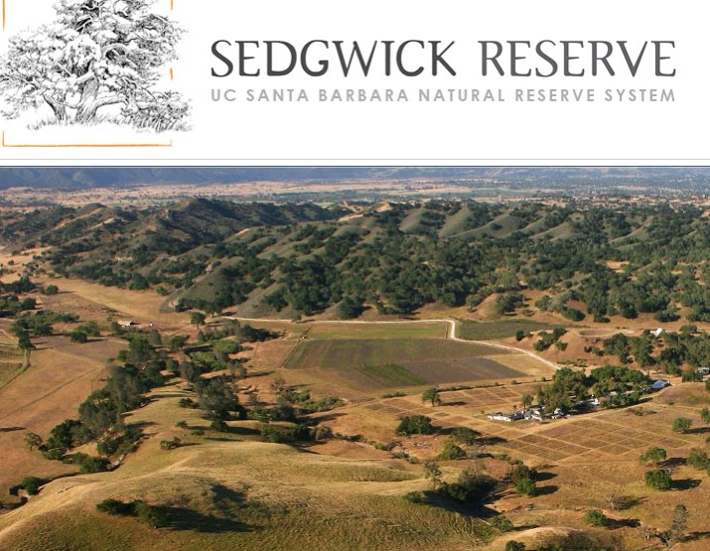
Deployment and Empirical Methodology

Slide 6
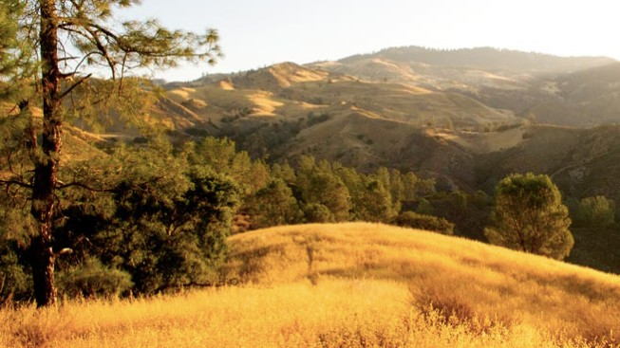
Deployment and Empirical Methodology

Slide 7
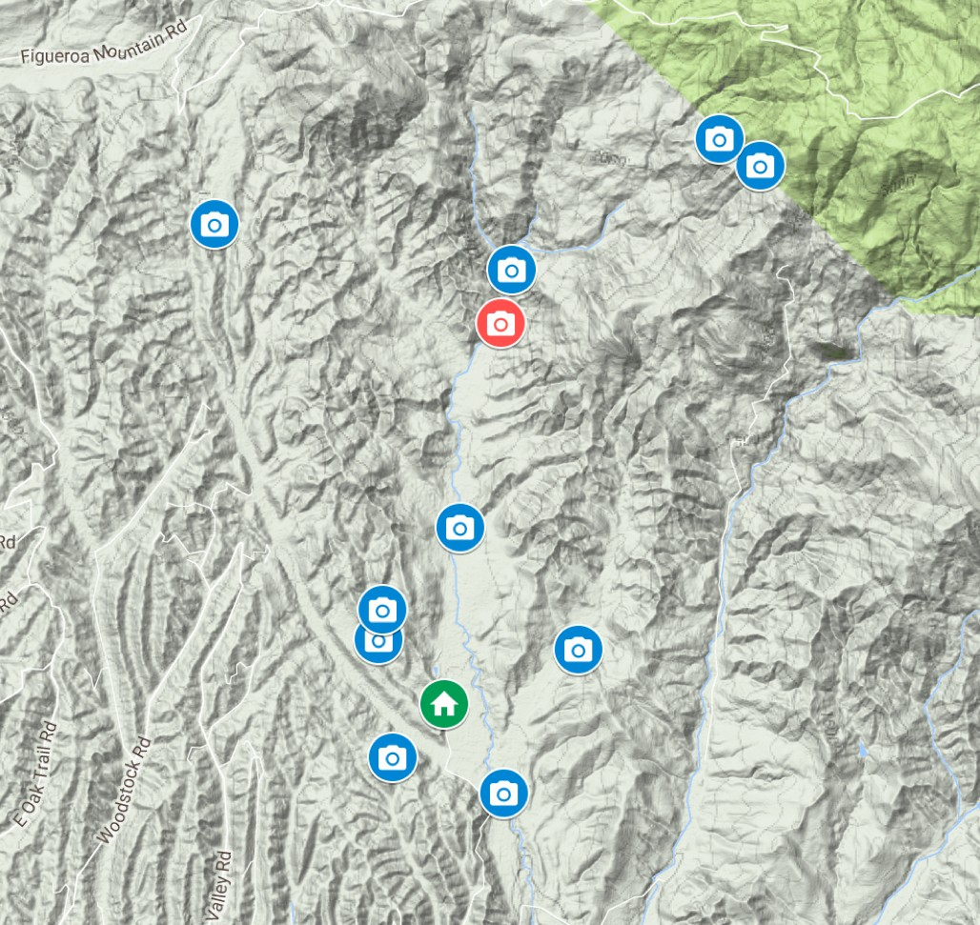
UCSB Sedgwick Reserve
Motion-triggered Wildlife Camera Traps
6000 acres
11 Camera trap locations
Total: 1.12 Million
Images: 714GB
This study: 238K
Images: 93GB

Slide 8

Image Classification
Enormous number of images (size and count)
Classification and identification once done by humans
Now automated by data analysis tools
Tensorflow
Other similar packages

Slide 9
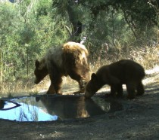
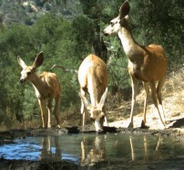
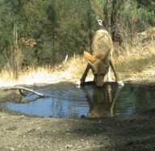

Image Classification: Training
Process: train a model then use it to classify images
Training set (large, manually labeled, ground truth)
Requires lots of compute power and GPUs (thanks public cloud!)
bear
deer
coyote
machine learning model

Slide 10



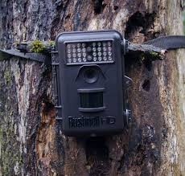


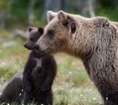
Challenges With IoT+Cloud for Wildlife Monitoring
Enormous numbers of images (size and count)
Cameras limited storage & processing power
Remote locations of Cameras: Very costly to upload images
Motion triggered cameras activated due to various factors.
Ecologists
Training
Labeling
Low Bandwidth Network Intermittent connectivity, shared, costly, high latency
Public Cloud

Slide 11



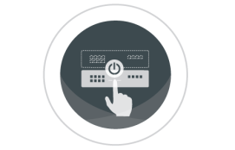
Where's The Bear (WTB)
Multi-tier IoT system
Perform classification near where the images are produced: Move the code to the data (images) not vice versa
Via Edge Clouds: robust, self-managing appliances, on-site
Low latency, high-bandwidth direct connectivity to cameras
Local image classification
Limited resources
= can classify but not train!
High Bandwidth, low latency network
UCSB Edge Cloud
Public Cloud

Slide 12
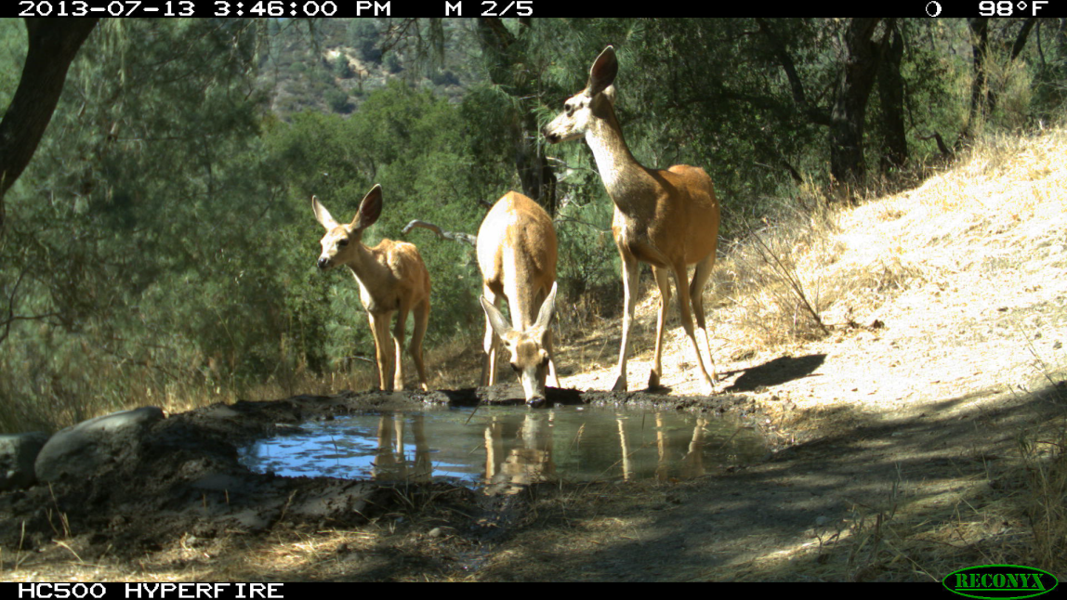
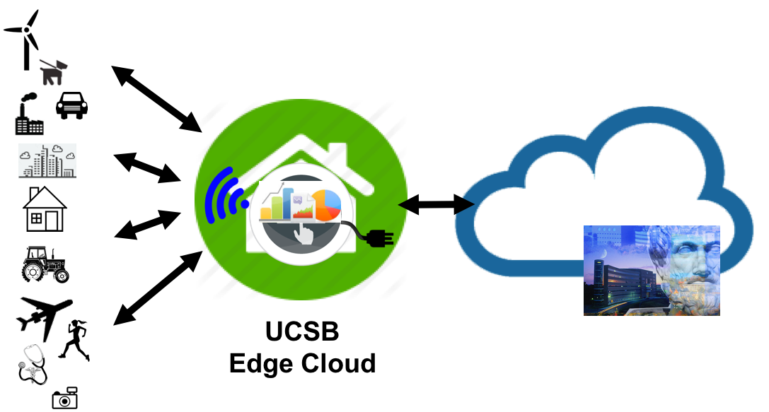
Edge Cloud
Extract images with animals
Scaled down version of AWS public cloud infrastructure: Eucalyptus
Automatic configuration
Transfer empty images to public cloud
Notes:
Elastic compute cloud
Simple storage service

Slide 13



WTB: Train Model In Public Cloud Using "Fake" Images
Public Cloud
Why Fake Images?
What are Fake Images?
Empty Images
Transmit a few "empty" images
from edge to public cloud (fast!)

Slide 14
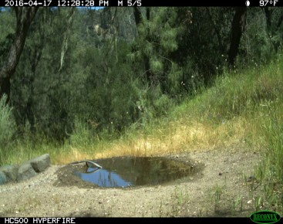
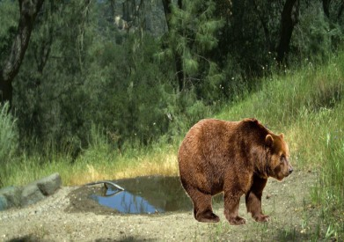
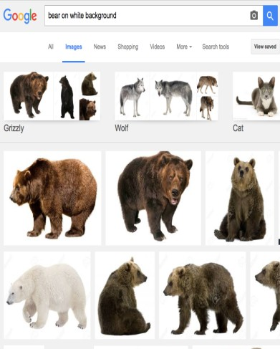
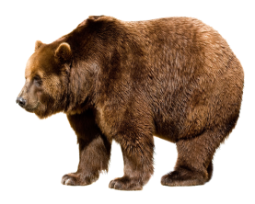
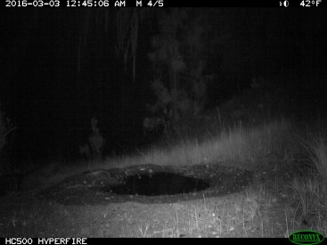
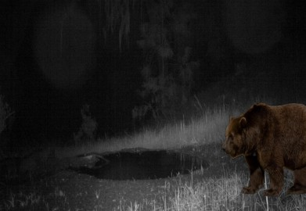
WTB: Train Model In Public Cloud Using "Fake" Images
Public Cloud
Produce many 1000s
of labeled training images automatically
Subtract background (OpenCV)
+
Empty Images
Random Images
Google Images
Transmit a few "empty" images
from edge to public cloud (fast!)

Slide 15
WTB: Train Model In Public Cloud Using "Fake" Images
Public Cloud
Subtract background (OpenCV)
Train the model
+
Empty Images
Random Images
Google Images
Transmit (tiny) model back
to edge cloud (fast!)
machine learning model

Slide 16

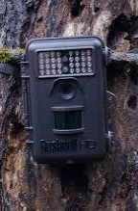

Where's The Bear (WTB)
Multi-tier IoT system
Move the code to the data (images) not vice versa
Via Edge Clouds: robust, self-managing appliances, on-site
Low latency, high-bandwidth direct connectivity to cameras
Local image classification using model trained in public cloud
Model training using "fake" images from "empties"
machine learning model
UCSB Edge Cloud
Public Cloud

Slide 17
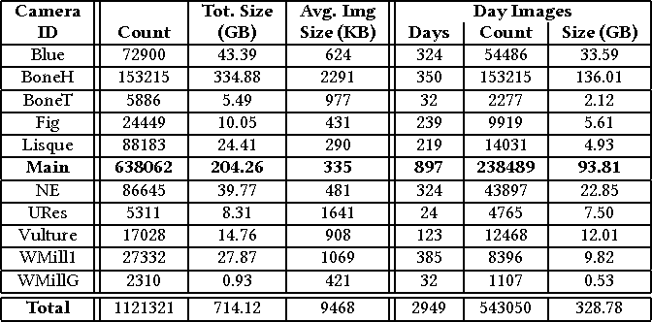
Camera’s in Details

Slide 18
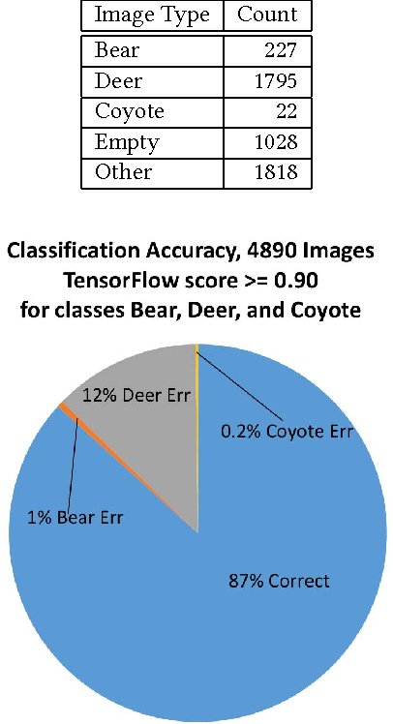
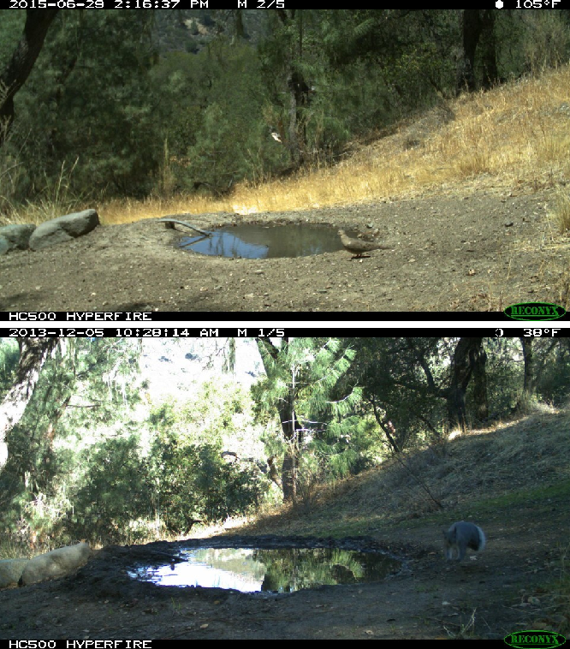
Classification by categorizing images:

Slide 19
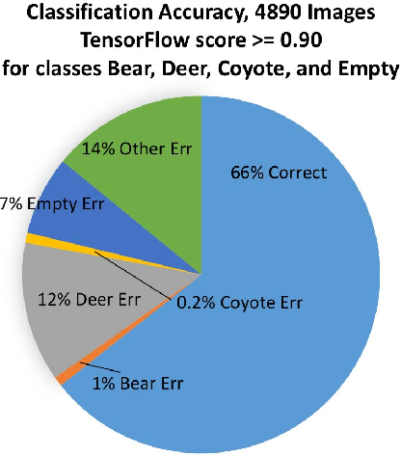
Results:

Slide 20
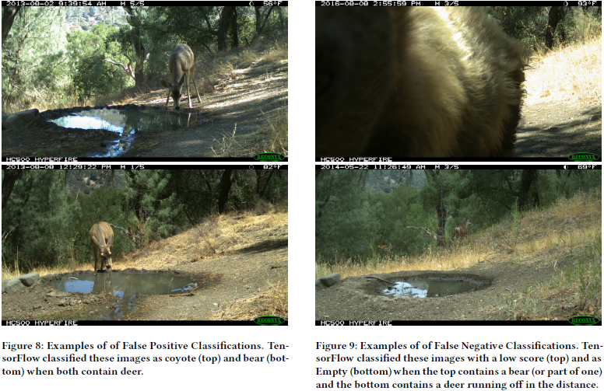
False Positive versus False Negatives

Slide 21
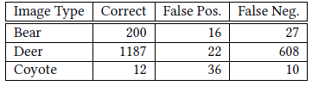
4890
randomly selected images
Results:
1473
images of interest transmitted
vs.
5.3 hrs vs. 1.6 hrs
Researcher time saved!

Slide 22
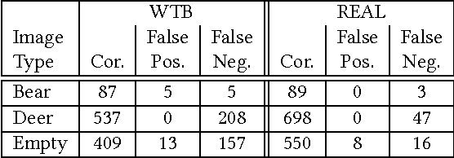
Results when WTB compared with the ‘Real model’
What is the ‘Real Model’
Just to measure the accuracy (%) of proposed model

Slide 23
WTB Conclusions and Future Work
Conclusion
Public cloud and edge cloud work together to solve problems
Can save significant researcher time (automatic classification)
Next steps
Small animals vs empty images, improving accuracy
Method to reduce the number of False negative images
Making edge cloud robust to outage and faults

Slide 24
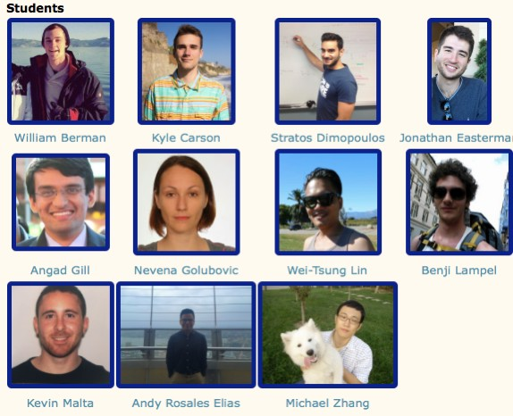
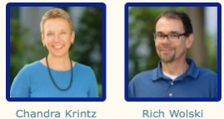

Thanks!
Collaborators:
UCSB, CalPoly, UCDavis, Fresno State, Powwow Energy,
Sedgwick Reserve,
UC Extension, Private Growers
Support:
Google, Huawei, IBM Research, Microsoft Research, NSF, NIH, California Energy Commission
ckrintz@cs.ucsb.edu
http://www.cs.ucsb.edu/~ckrintz/racelab.html

